Slide 1
“CECIO”
Brian Margosian

Slide 2
What?
Tractive System
Magneti Engine ECU
Inverters
dSPACE Micro
AutoBox
ETC
BMS
Dashboard / Radio system
Sensors

Slide 3
What?
Tractive System
Magneti Engine ECU
Inverters
CAN Bus
dSPACE Micro
AutoBox
CAN Bus
ETC
CAN Bus
CAN Bus
BMS
Digital I/O
Dashboard / Radio system
Serial / I2C
CAN Bus
Sensors

Slide 4
CAN Module
Eliminate the need for large harnesses
Quick way to add modules or devices later to the system
CAN Module
SPI
dSPACE MicroAutoBox
I2C
CAN Bus
CAN Module
DIGITAL
ANALOG
CAN Module
DIGITAL
ANALOG
PWM

Slide 5
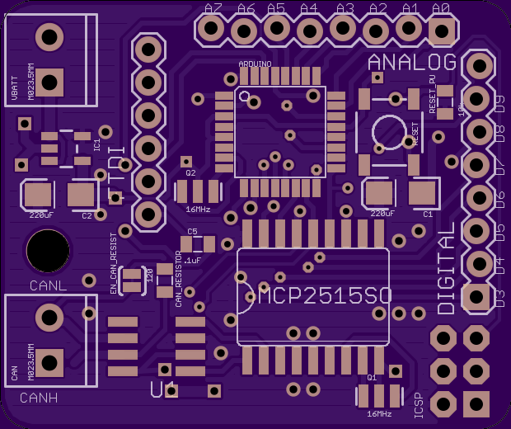
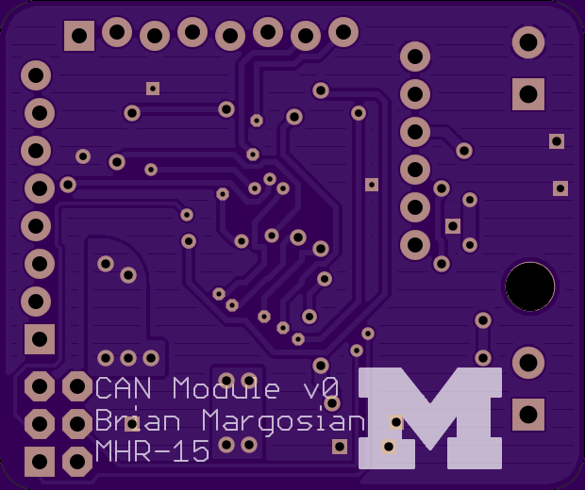
CAN Module

Slide 6
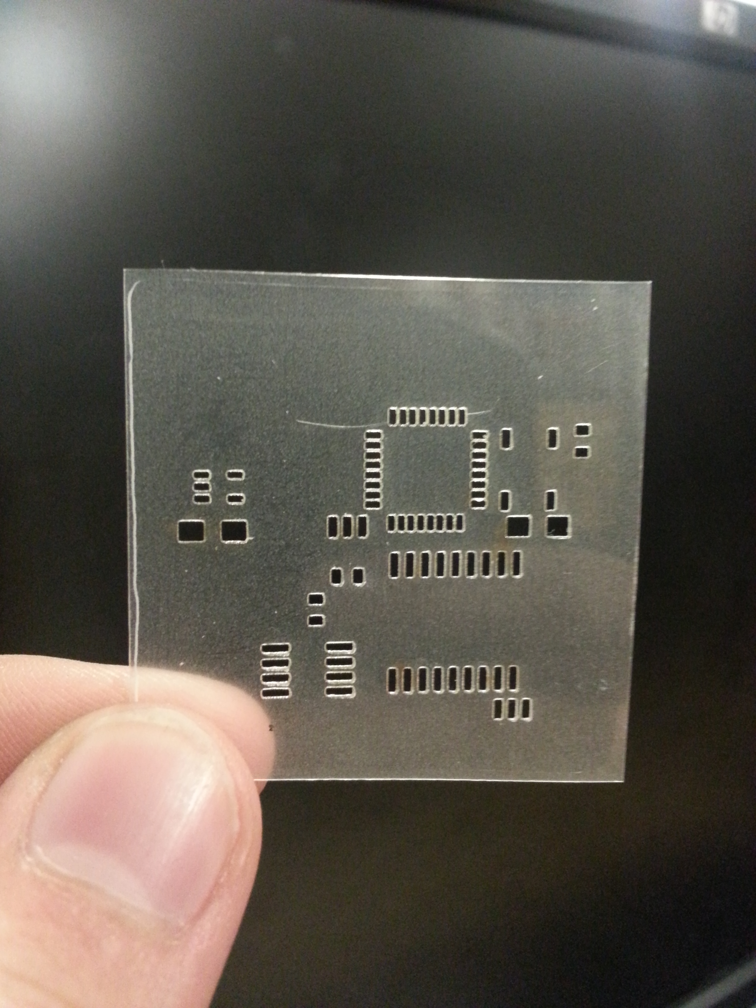
CAN Module
Stencil for surface mount components
Way forward:
- Solder together boards
- Test software
- Choose vehicle components for implementation

Slide 7
ETC
Allow fine control of throttle for efficiency
Reduce waste caused by direct throttle cable
Fail-safe modes
Throttle Body
dSPACE MicroAutoBox
CAN Bus
CAN Module
DIGITAL
Servo Motor
TORQUE
PWM
Remember me?
SENSOR DATA

Slide 8
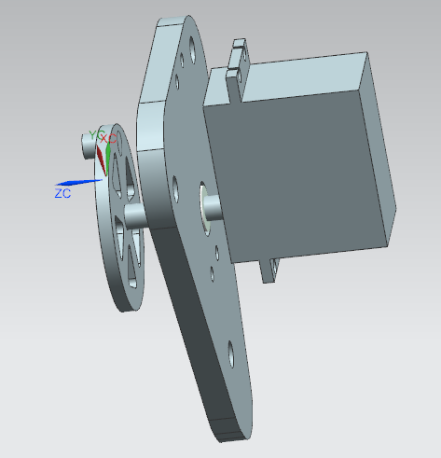
ETC
Way forward:
- Create prototype out of
plexiglass
- Test torque output of servo to throttle
- Create final product with aluminum
- Integrate on vehicle

Slide 9
ETC

